Slide 1
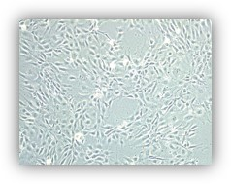
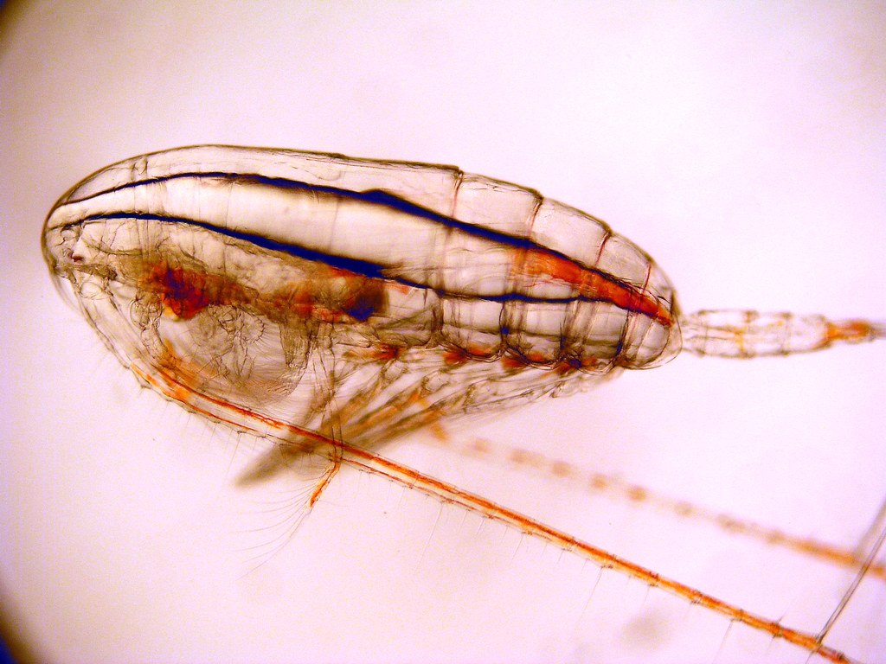
USE OF THE ZEBRAFISH CELL LINE ZF-4 TO EVALUATE THE CYTOTOXIC EFFECT OF ANTIOXIDANT PROTEIN HYDROLYSATES FROM MARINE COPEPODS (Calanus finmarchicus)
Martínez-Alvarez O¹, Slizyte R², Mozuraityte R², Albrektsen S³, Standal I²
1 Institute of Food Science, Technology and Nutrition (ICTAN, CSIC); 2 SINTEF Ocean, Trondheim (Norway); 3 NOFIMA, Bergen (Norway). Correspondence: oscar.martinez@ictan.csic.es
Calanus finmarchicus is a free-living copepod that forms part of the zooplankton. It is known that Calanus are a rich source of protein and PUFA. Proteases can hydrolyze this protein, producing astaxanthin-containing hydrolysates that may serve as antioxidant ingredients in animal feed (for example for salmon), and human food. However, it is necessary to evaluate their toxicity before using them as a functional ingredient.
The zebrafish is an interesting model used to study human diseases. Zebrafish cell lines are useful in drug discovery due to their advantages and potential for rapid screening assays of bioactivity of molecules without using whole organisms, which raises ethical concerns.
Calanus finmarchicus
The aim of this study is to assess the cytotoxicity of antioxidant protein hydrolysates from Calanus finmarchicus using the ZF-4 zebrafish embryonic cell line.
ZF-4 Cell line
The marine zooplankter Calanus finmarchicus were harvested by fishing vessels in the North Sea. After capture, they were lyophilized and their protein was hydrolyzed using various commercial enzymes: Protamex from Novozymes (Sample P), Papain/Bromelain from Enzybel (Sample P/B), Promod 950L/Flavorpro 766 MDP from Biocatalysts (Sample P/F). Also, endogenous enzymes were used (Sample E). In addition, one sample was subjected to an industrial ensiling process at acidic pH (Sample S).
The study evaluated the cytotoxic capacity of the protein hydrolysates at different concentrations (1, 5, 10 mg/ml of medium) using a CCK-8 cell viability kit. Cells ZF-4 were previously grown to confluence at 28°C and 5% CO₂ in DMEM-F12 medium with fetal bovine serum (FBS, 10%) prior to testing.
None of the samples resulted in increased cell proliferation or significant cytotoxicity at the concentrations tested. The hydrolysates caused a slight decrease in cell viability that was not concentration dependent and not always significant. However, cell viability always remained above 87%. The results showed that the lowest cell viability was observed when analyzing the effect of silage at 10 mg/ml, probably because of the low pH. These results suggest that these samples, with known antioxidant capacity, could be incorporated as an antioxidant ingredient in animal or human foods.
Protein hydrolysates from Calanus finmarchicus, with known antioxidant activity, do not show any cytotoxic effect on zebrafish embryonic cells at the tested concentrations, and could be incorporated as safe antioxidant ingredients, rich in amino acids and peptides, in food and/or animal feed.
Acknowledgment: Grant PID2020-116142RB-I00 funded by MCIN/ AEI/10.13039/501100011033/. Grant ref. 320536 funded by The Research Council of Norway

