Slide 1
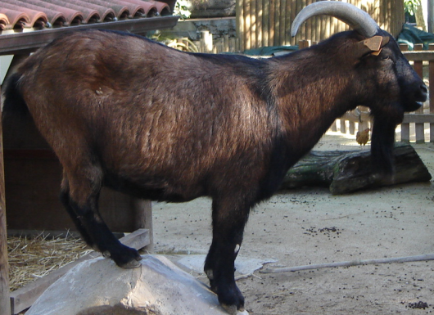
The Proteomics Workflow
GEL BASED
Quantify (2DE)
Digest
Mass Spec
IDENTIFICATION OF DIFFERENTIALLY EXPRESSED PROTEIN
Protein extract
Fluid
Cell
Tissue
Organ
Organism
Digest
Separate
Mass Spec
Quantify
GEL FREE

